Slide 1
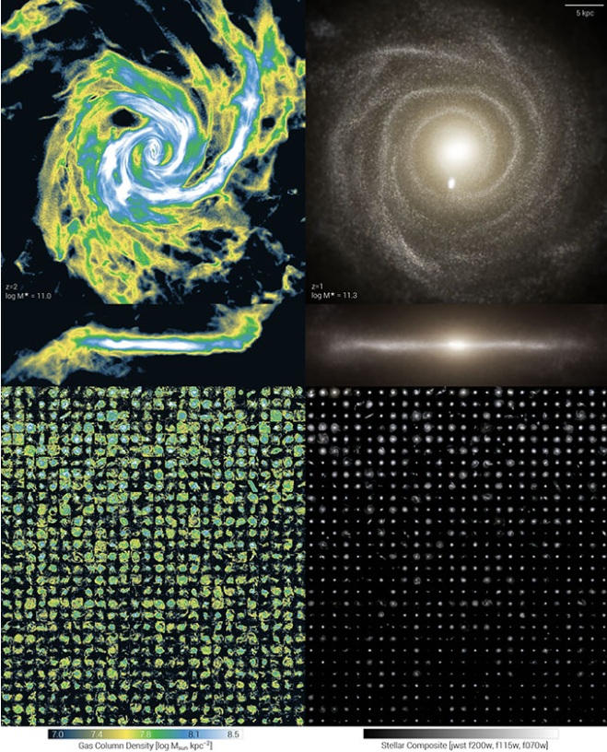
Numerical Simulation of a Community Paediatric Service
Dr Raman Sharma
Community Paediatric Consultant
30/09/2025

Slide 2

Introduction
Referral rates are increasing
Wait times are increasing
Why?
Aim – Use Python to create a model that outputs waiting time under different input variables

Slide 3
What are the dependencies?
DEMAND
CAPACITY
Number of Referrals = New Appointments
Number of Staff
Number of clinics
Patient age distribution+Diagnosis Distribution
New/F/U ratio in clinics
DNA rates
Lifetime follow up burden per case

Slide 4
Other assumptions
Diagnosis Distribution varies as a function of age – use a cutoff
Age distribution in the population can be modelled with a skewed normal fit
Different staff types will have different capacities.
Same staff type has same capacity
Not all New cases seen need to be followed up
All follow up appointment types are the same

Slide 5
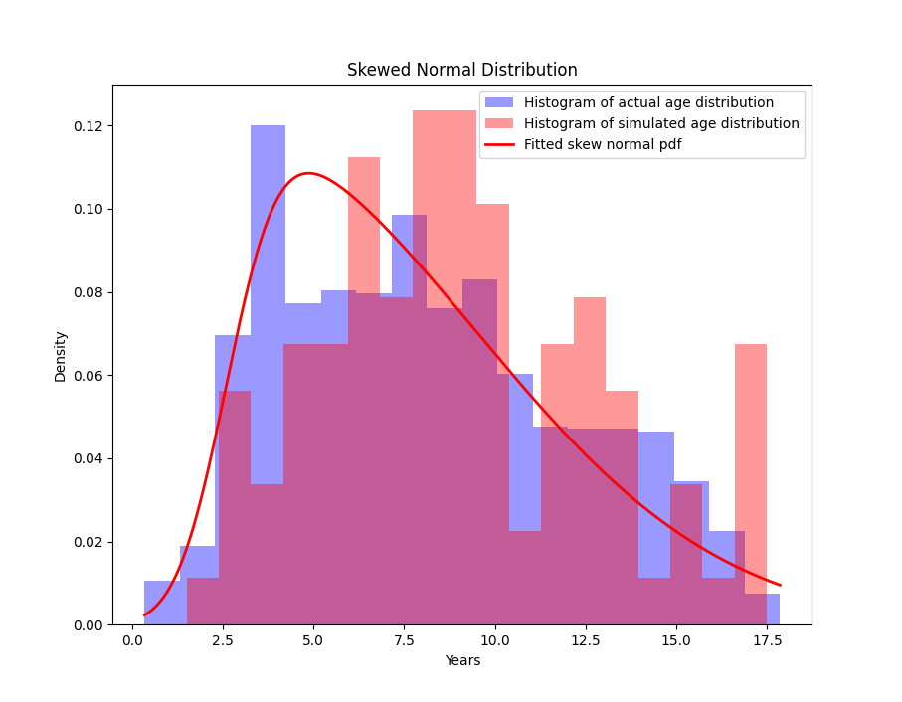
Method
Using last 3 years data –
age distribution modelled
(Including a delay)
ADHD/ASD and Complex disorder rates
calculated and hard coded from
last complete referral year
Mean annual follow up rates for
diagnosis and follow up estimated
for each condition

Slide 6
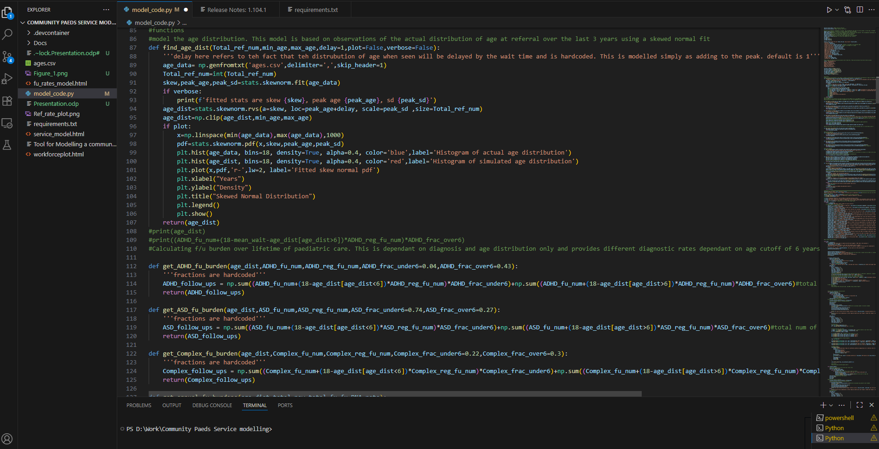
CODE
Python scripting – VS Code IDE
Streamlit library to distribute
as a webpage
Github-
(https://github.com/SpaceElmo/Community-Paeds-Service-modelling)
Streamlit Webpage
Comm Paeds Model

Slide 7
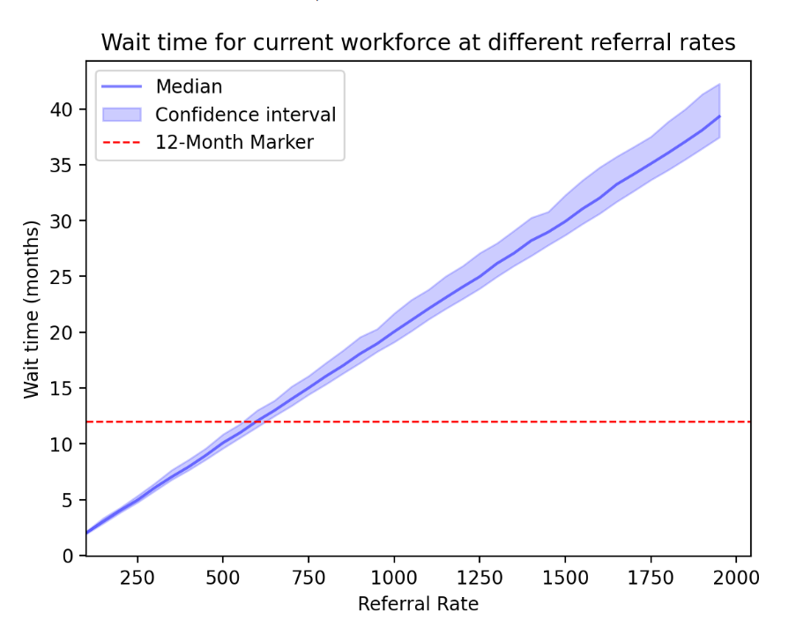
Results

Slide 8
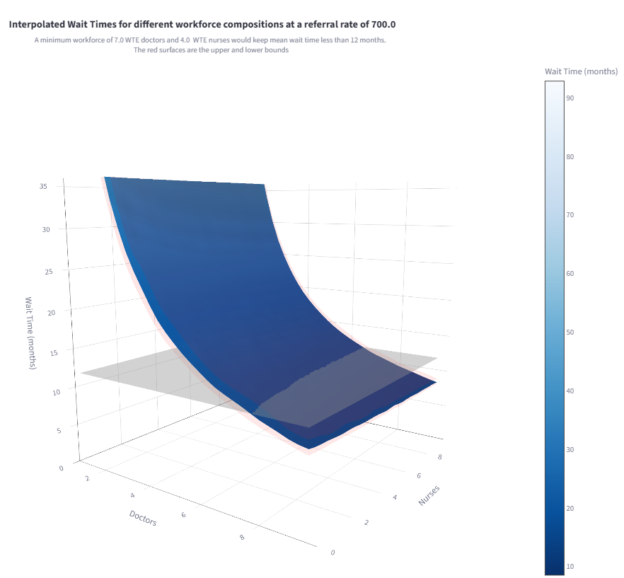
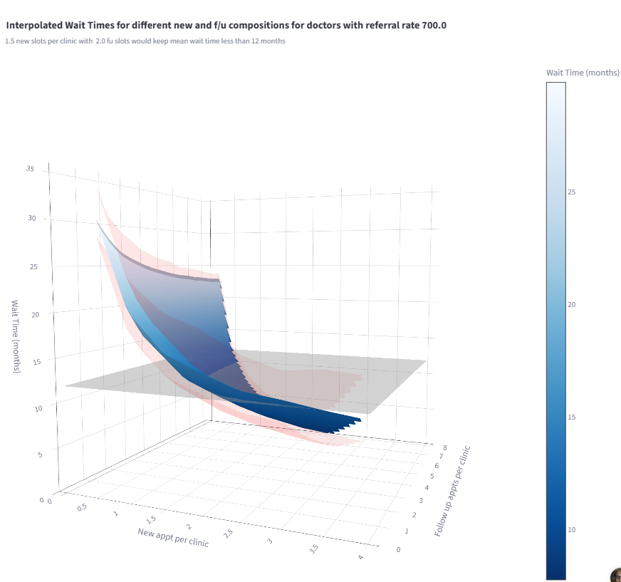

Slide 9
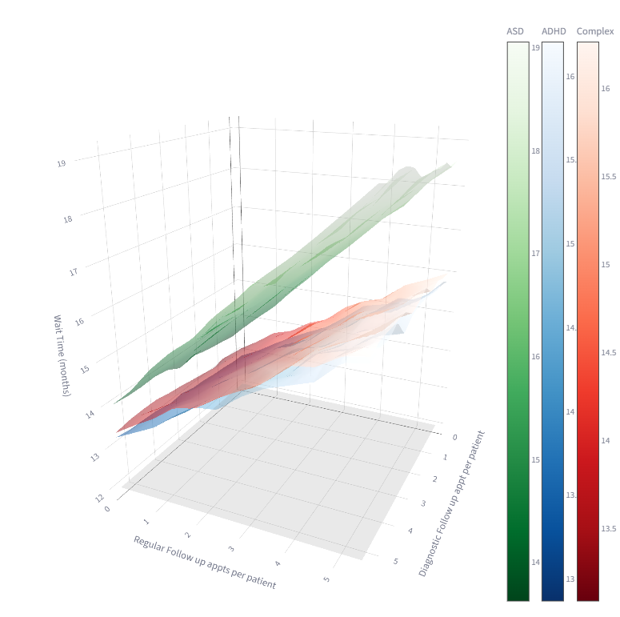

Slide 10
Conclusion
The median wait time increases at a linear rate with referral number
The number of doctors that the service has, has a greater influence on wait times than the number of nurses although increasing the number of nurses can have an impact in a service with fewer than 2 doctors.
Changing the ratio of new to follow up in each clinic has a large impact on waiting times. Ratio is dependant on Referral rate
Reducing the number of follow ups for ASD patients had the biggest impact on reducing waiting times compared to ADHD and Complex patients.
This model does not take into account clinical triage decisions that may reduce the waiting time for a sub group of patients.
The model does not account for services that do not run a doctor led assessment process

Slide 11
References and Acknowledgement
1) Nuffield Trust: Access to services for Autism and ADHD
2) Lets Do Digital https://letsdodigital.org/

